Slide 1
SALES MARKETING
v/s
+
v/s
+
Kaushal Veluri
Director – Marketing, Citrix Systems

Slide 2
What’s common ?

Slide 3
Why?

Slide 4
What is the issue?
PERCEPTION
MEASUREMENT

Slide 5
But wait……..
Do we need to align Sales & Marketing?

Slide 6
YES!
v/s
20% average growth in annual revenue
4% -ve growth in annual revenue.
47% of sales forecast generated by Marketing
5% of sales forecast generated by Marketing
Aberdeen Group Research

Slide 7
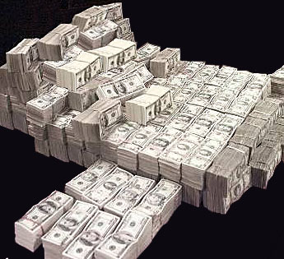
Sales
Marketing

Slide 8
PERCEPTION

Slide 9
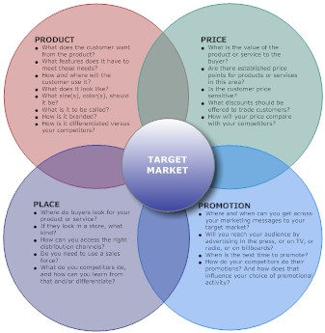
Marketing View
Events
PR
PR
Positioning
PR
Demand Gen
Events
PR
Demand Gen
PR
Market Research
Events
Branding
Publicity
Print
Branding
Branding
Print
Website
Branding
Positioning
Website
Digital Marketing
TV / Radio
Website
TV / Radio
Events
Segmentation
Social Media
Brand Mgmt
Events
Direct Mail
Direct Mail
Demand Gen
Website
Branding
Website
Demand Gen
Brand Mgmt
Positioning
Market Research

Slide 10
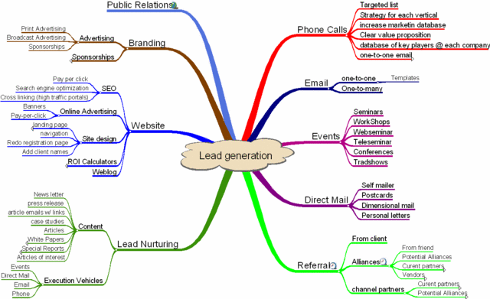
Sales View

Slide 12
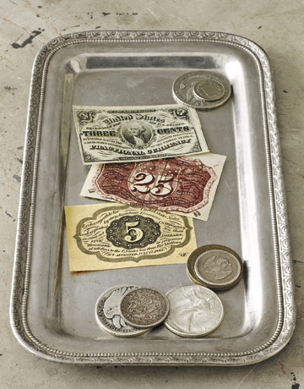

Slide 13
MEASUREMENT

Slide 14
Key Metrics for alignment
Marketing’s contribution to sales pipeline
Marketing generated leads converted into opportunities.
Aberdeen Group Research

Slide 15
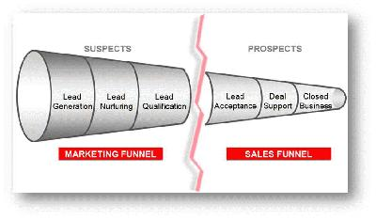

Slide 16
Perception Gap Analysis
Outstanding
Marketing
Sales
Very
Satisfactory
Satisfactory
Average
Not
Satisfactory
Poor
Horrible
Lead
Quantity
Lead
Quality
Lead
Response
Lead
Distribution
Lead
Value
Lead
Closure

Slide 17
So how do we bridge the gap ? How do we align?

Slide 18
TAG’EM Process
TALK
Talk to each other.
Do the Perception Gap Analysis Exercise.
Understand Business goals and objectives.
Go out on the field with your sales person.
Share your marketing plans with the sales teams.
Make them understand how it ties to business and more importantly to them.
AGREE
Discuss on objectives and agreed results.
Get agreement with all stakeholders in sales and marketing.
Agree on the why’s, where’s, how’s and what’s of the marketing plan.
Get Buy-In!
GOAL
Define the objective of each activity
Awareness ?
Education ?
Demand generation ?
Define the key metrics to be used to measure success.
Number of attendees ?
Number of leads ?
Number of downloads ?
Define Roles & Responsibilities for lead management.
EXECUTE
Communicate the execution process and roles & responsibilities with everyone – including sales.
Ensure Flawless Execution!
MEASURE
“What you can’t measure, you can’t manage”
Measure, Measure and Measure.
Set a process – automated or manual – to track measurement of objectives and metrics set earlier.
Communicate regularly the status of metric measurement to the stakeholders.

Slide 19
T.A.G.E.M Process
AGREE
Discuss on objectives and agreed results.
Get agreement with all stakeholders in sales and marketing.
Agree on the why’s, where’s, how’s and what’s of the marketing plan.
Get Buy-In!

Slide 20
T.A.G.E.M Process
GOAL
Define the objective of each activity
Awareness ?
Education ?
Demand generation ?
Define the key metrics to be used to measure success.
Number of attendees ?
Number of leads ?
Number of downloads ?
Define Roles & Responsibilities for lead management.

Slide 21
T.A.G.E.M Process
EXECUTE
Communicate the execution process and roles & responsibilities with everyone – including sales.
Ensure Flawless Execution!

Slide 22
T.A.G.E.M Process
MEASURE
“What you can’t measure, you can’t manage”
Measure, Measure and Measure.
Set a process – automated or manual – to track measurement of objectives and metrics set earlier.
Communicate regularly the status of metric measurement to the stakeholders.

Slide 23
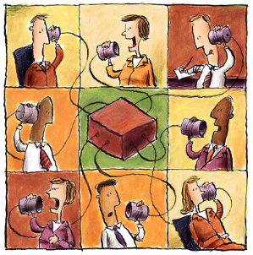
TAG’EM Process
Talk
Agree
Goal
Measure
Execute

Slide 24
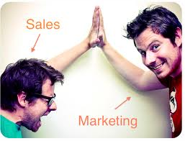
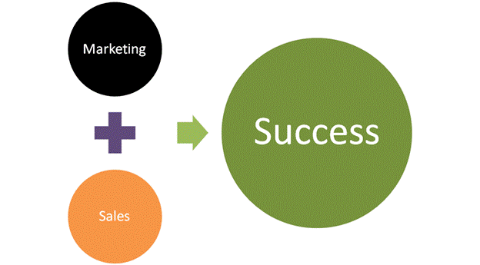

Slide 25
THANK YOU!
kaushal_veluri@yahoo.com

